Slide 1
CIS 3200 Term Presentation
Christopher Valdepena
Jiancong Zhang
My Truong
Ryan Applegate

Slide 2
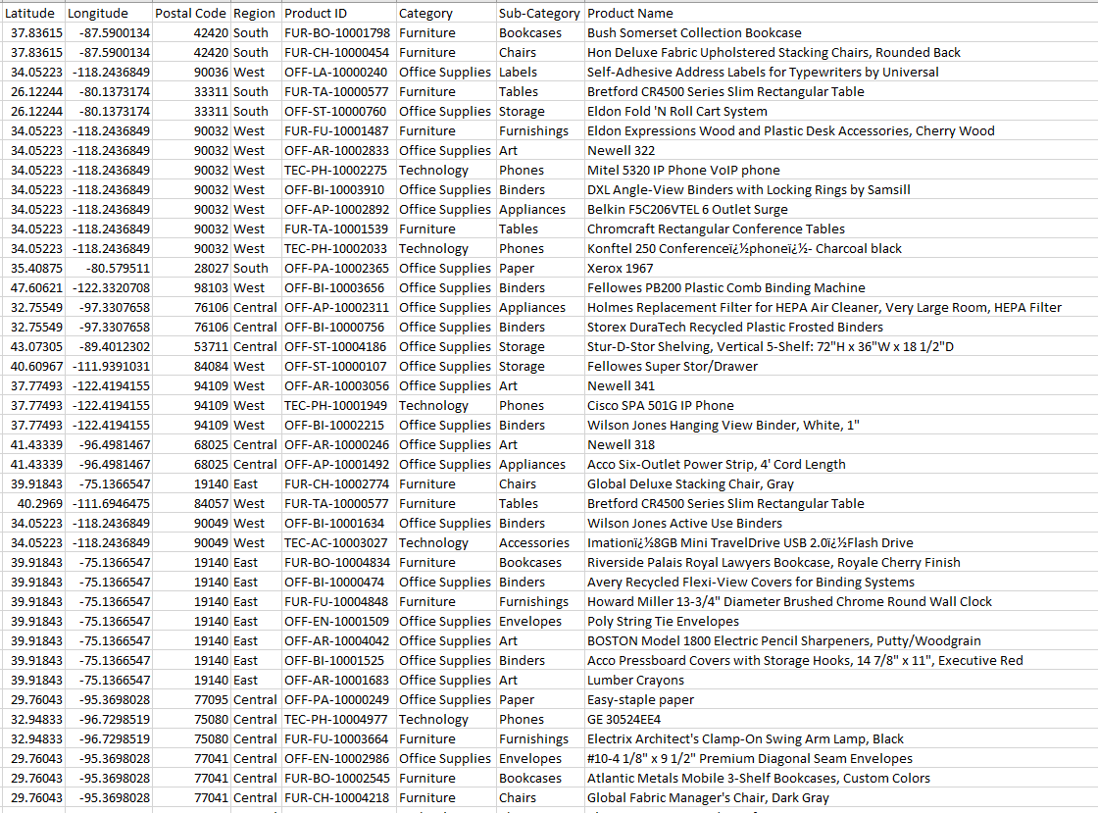
Brief Summary of Our Dataset
<Maybe a snapshot of the data in excel?>
24 columns/dimensions
9,995 records
~ 3MB
<shorturl.at/dnHIW>(Data)
*Snapshot of dataset
Notes:
-Explain original data source & where to find Github repository
- How we plan to utilize the data and what our expectations are (potential insights, visualizations...etc)

Slide 3
Retail Superstore
Summary:
A retail super store has been in operation for the past 4 years while collecting consumer and sales data
Data is managed on-site with no data analytic tool implementation

Slide 4
Retail Superstore
Significance
Larger companies and organizations are leveraging their data, staying leaps ahead of private business owners
We want our analysis to apply to a real-world issue.

Slide 5
Retail Superstore
Our group has been contracted by the company to produce an analytical dashboard
The overall business objective focuses on developing and producing a business process for the retail superstore to maintain future analytics

Slide 6
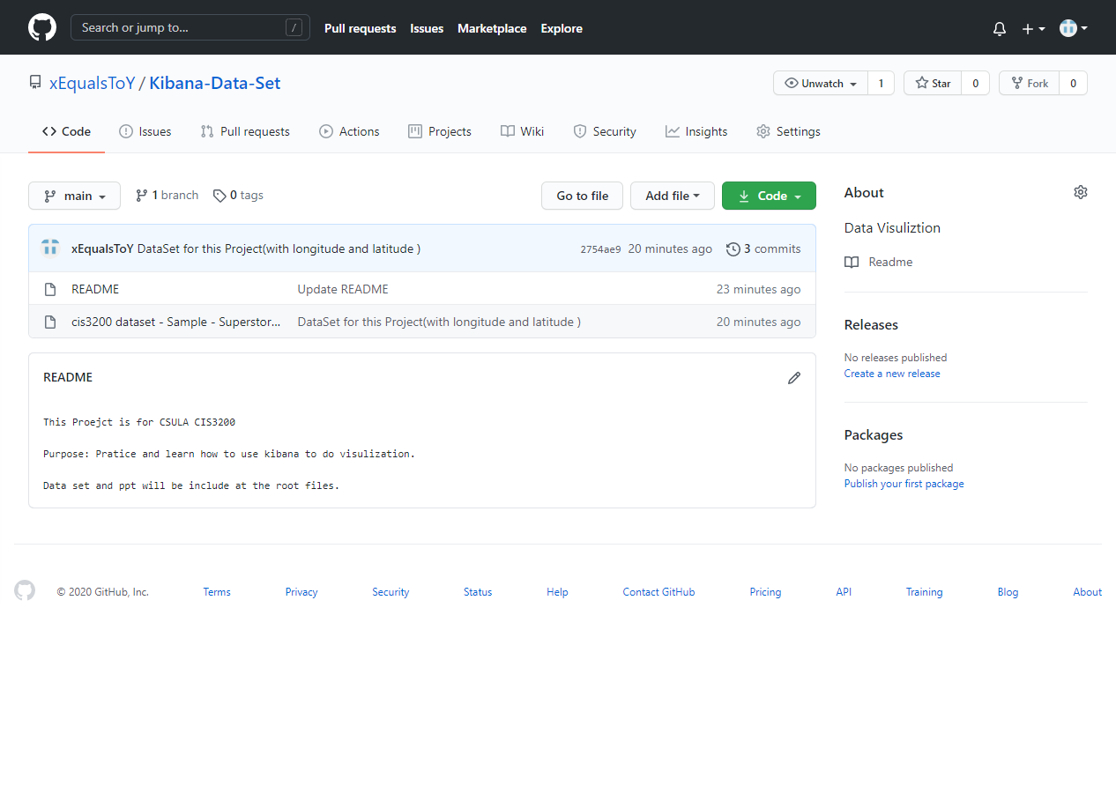
Where is Our Dataset & what is in our Github
24 columns/dimensions
9,995 records
~ 3MB
<shorturl.at/ilpAO>(GitHub)
*Snapshot of Github Repository
Notes:
Where Do we find the data set, and what else is there
what are we going to do with the data

Slide 7
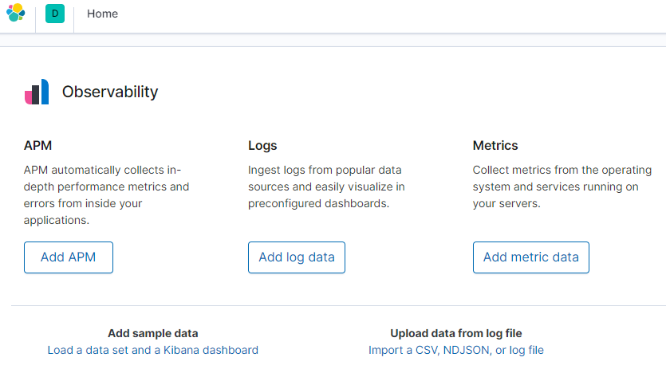
Data Set
Upload the data by using the Import function from kibana’s home page

Slide 8
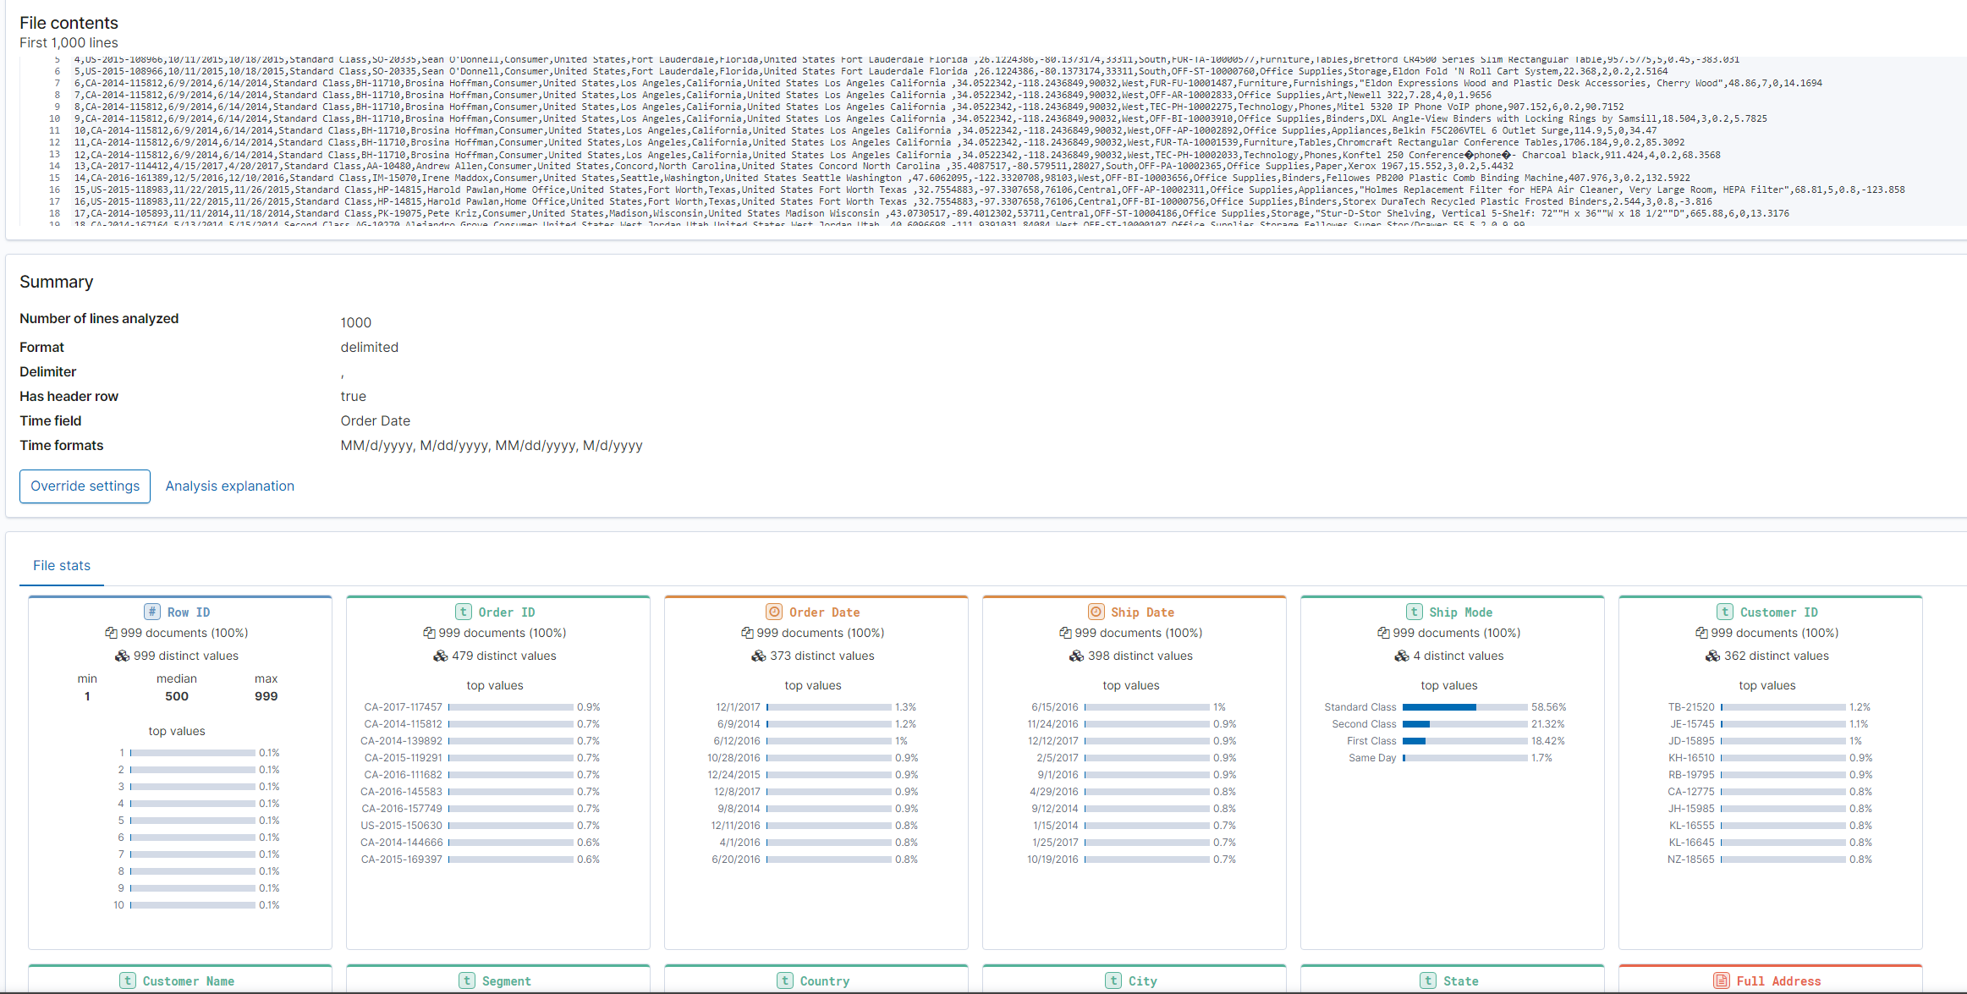
Elasticsearch

Slide 9
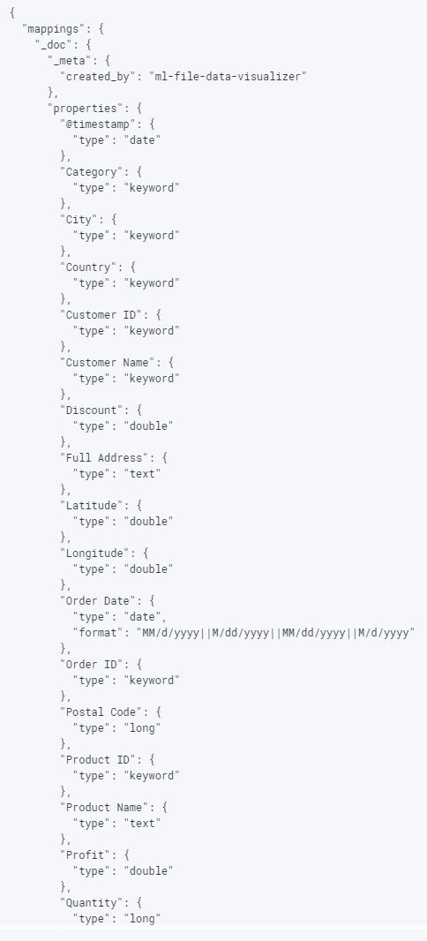
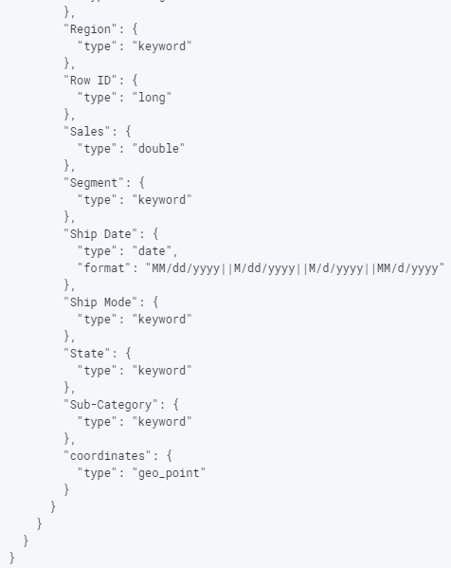
Elasticsearch
Longitude & Latitude dimensions were added prior to import
},
"coordinates": {
"type": "geo_point"
}

Slide 10
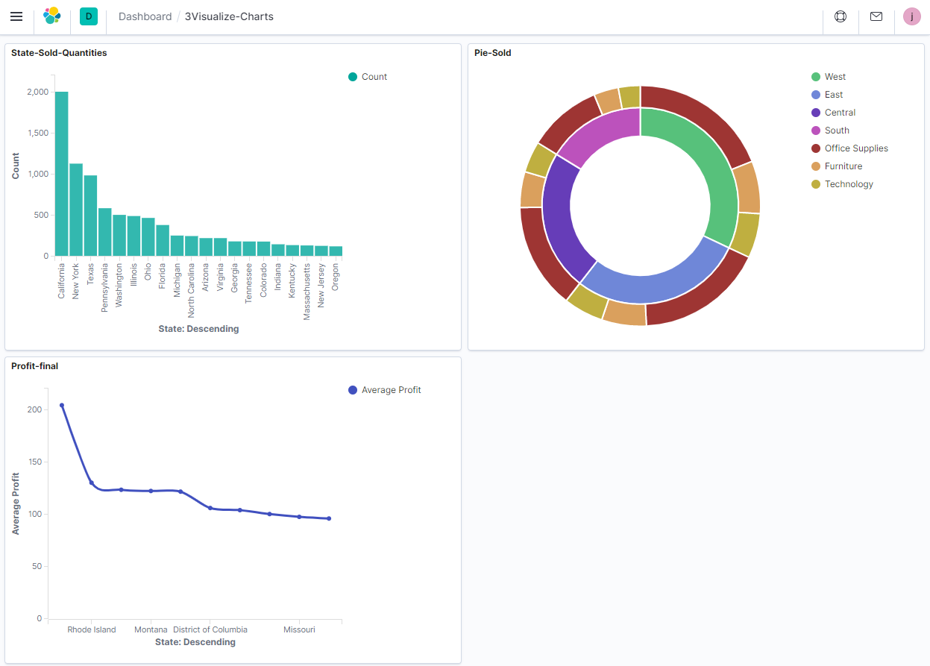
Elasticsearch
Profits and sales vizualized in various graphs.
Each graph has its own properties and categorization.
Notes:
Here we have 3 graphs outlined which which we will go over in more detail in the following slides, but basically, each graph visualizes the profits and sales by region or state from previous dates. Using theses graphs we can utilize our resources to improve our results in the future.

Slide 11
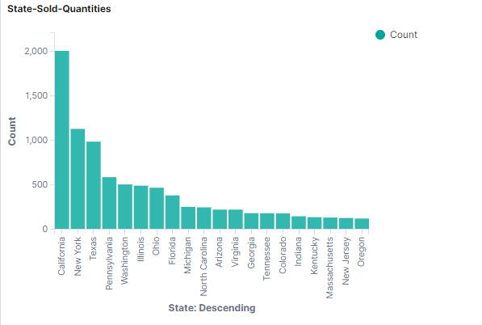
Elasticsearch
What’s your 1st opinion?
This graph visualizes the amount of sold products in various states in descending order.
Notes:
So first, we have the vertical graph which visualizes the amount of sold quantities in different states

Slide 12
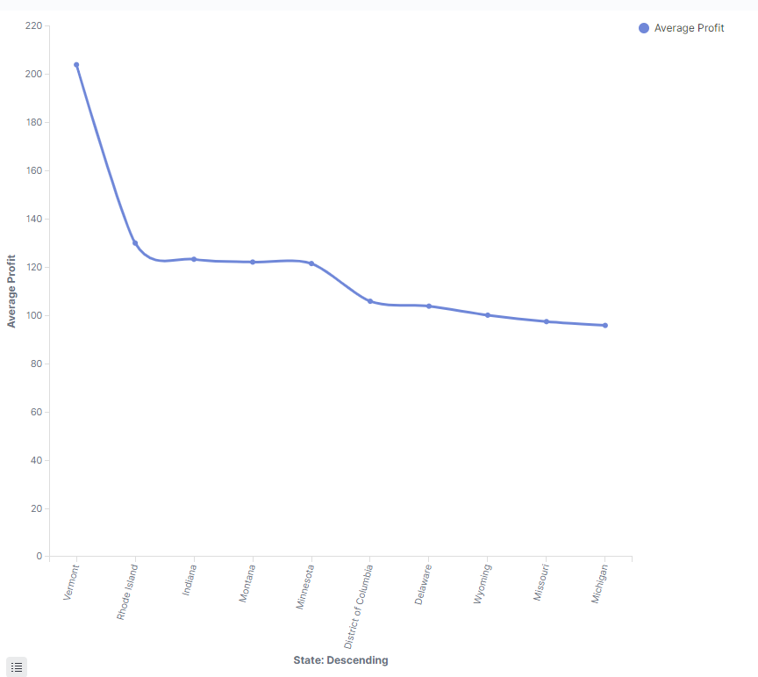
Elasticsearch
something may unexpect
This graph visualizes the average profits earned at various states in descending order.

Slide 13
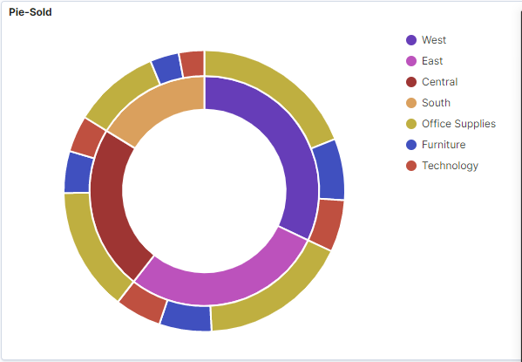
Elasticsearch
Deeper insights
This graph visualizes the amount of sold office supplies, furniture, and technology in different regions.

Slide 14
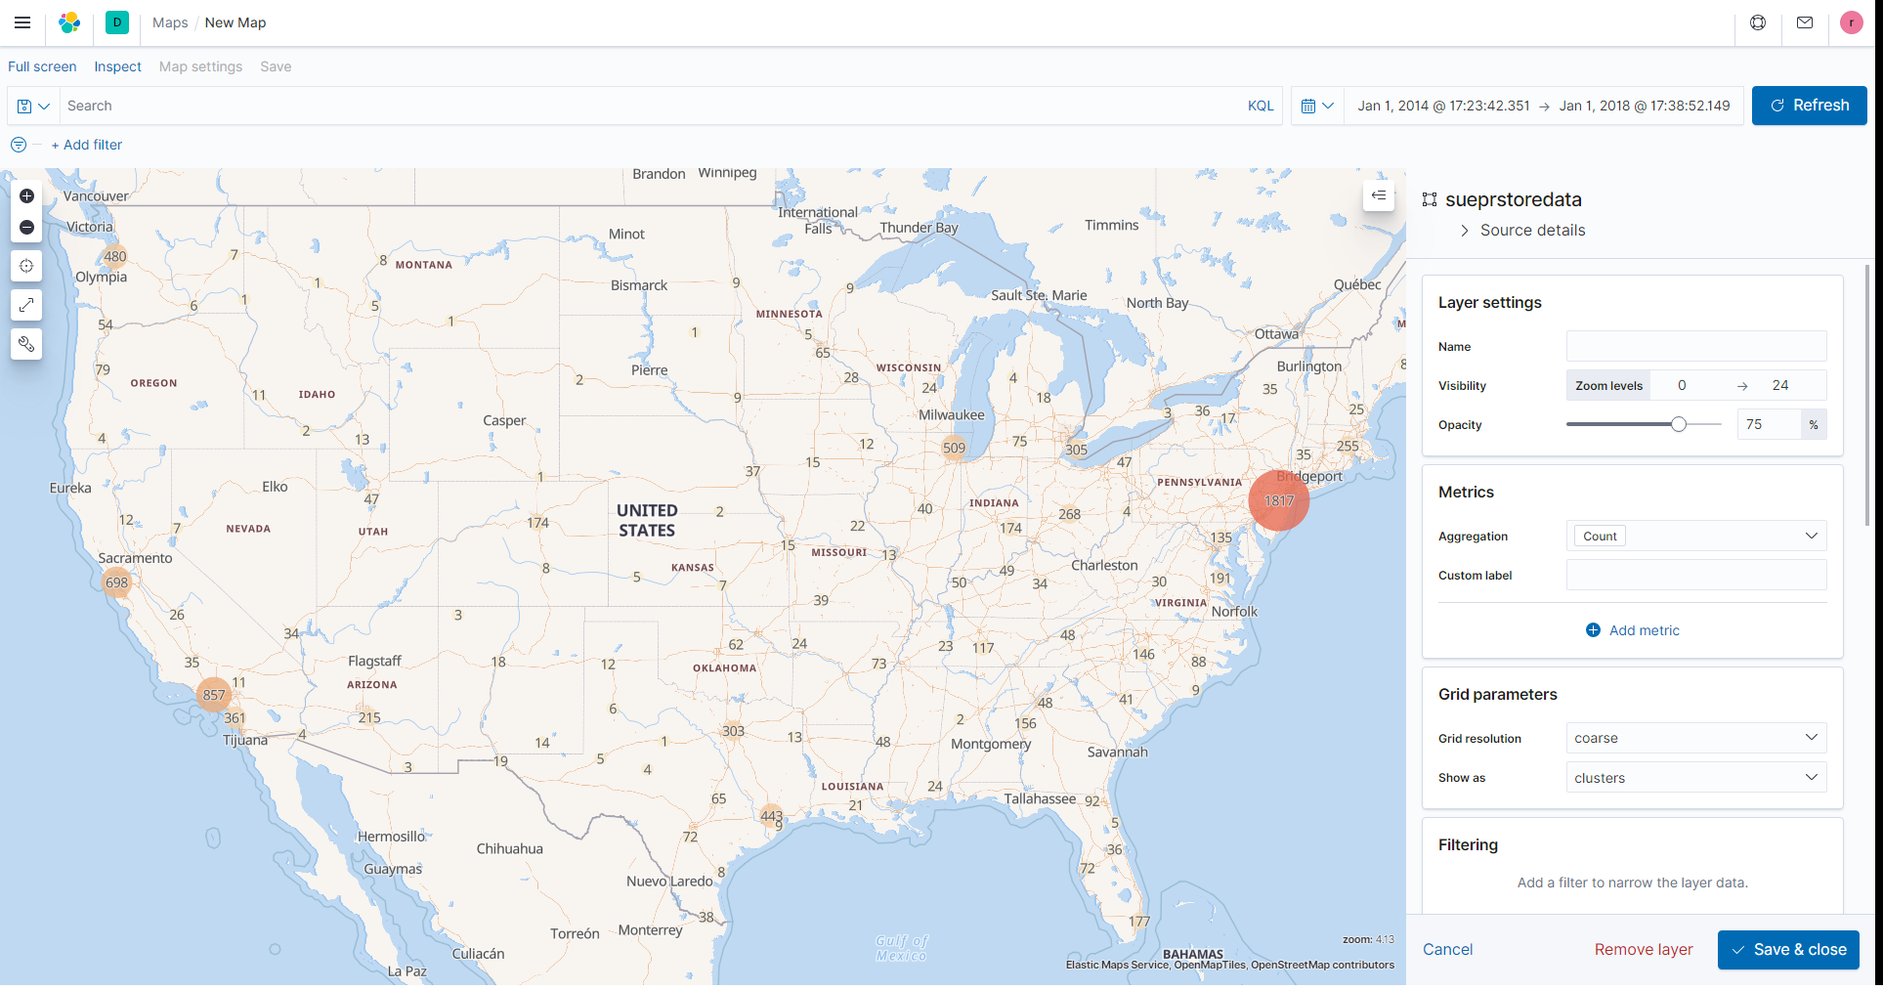
Elasticsearch-
Kibana
Tempo-Spatial Map
Broad overview of total sales subsets
Location of major markets
Notes:
<Notes for whomever covers this slide>
Full view of all sale counts for the past 4 years of operation
Can see where marketing campaigns should be focused
Helps narrow down where we want drill downs for further analysis

Slide 15

Conclusion&Future
Data visualization tools provide us with new methods that can significantly improve our ability to grasp the information hidden in the data
Notes:
It is easier to absorb and grasp information through vision and images than text and numbers. Nonetheless, most business intelligence reports prepared for senior managers are usually filled with static tables and graphs that cannot provide vivid information to those viewing it. In contrast, data visualization enables users to receive large amounts of information about operating and business conditions. Data visualization allows decision makers to view the connections between cubes and provide new ways of interpreting data through the use of heat maps, geographic maps, and other rich graphical representations.
today, the data that companies can collect about customers and market conditions can provide business leaders with insights into new revenue and business opportunities-they can discover opportunities from a large amount of data. Using data visualization, decision makers can more quickly grasp changes in customer behavior and market conditions across multiple data sets.

Slide 16

Group 2.
Thank you!
Q&A Time.

